Slide 1
Investigation of Image Classification based on Transfer Learning and Siamese Network
Ke Fan, Abdullateef Almudaifer, Sungman Kang

Slide 2
Agenda
Objective
Transfer Learning
Siamese Network
Dataset Processing
Implementation
Evaluation

Slide 3
Objective
Compare a simple Siamese network classification with transfer learning approach.
Investigate the effect of Siamese network on transfer learning

Slide 4
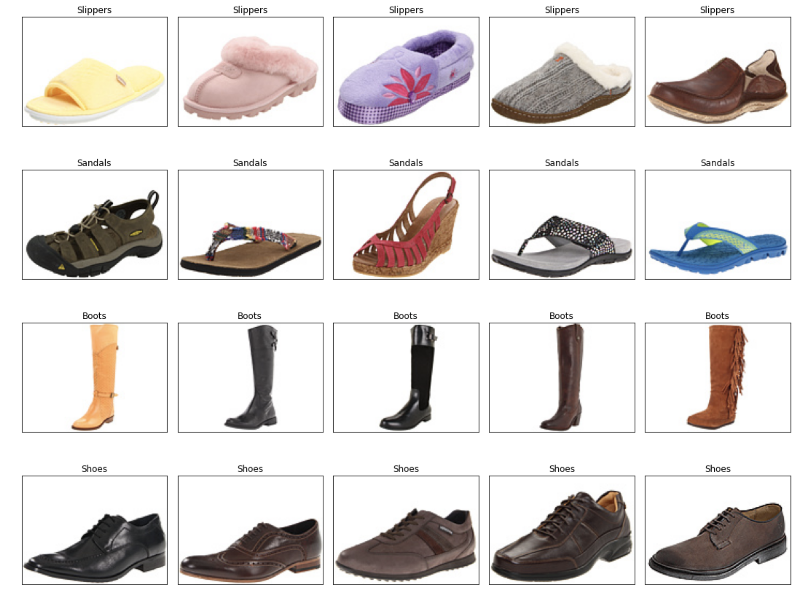
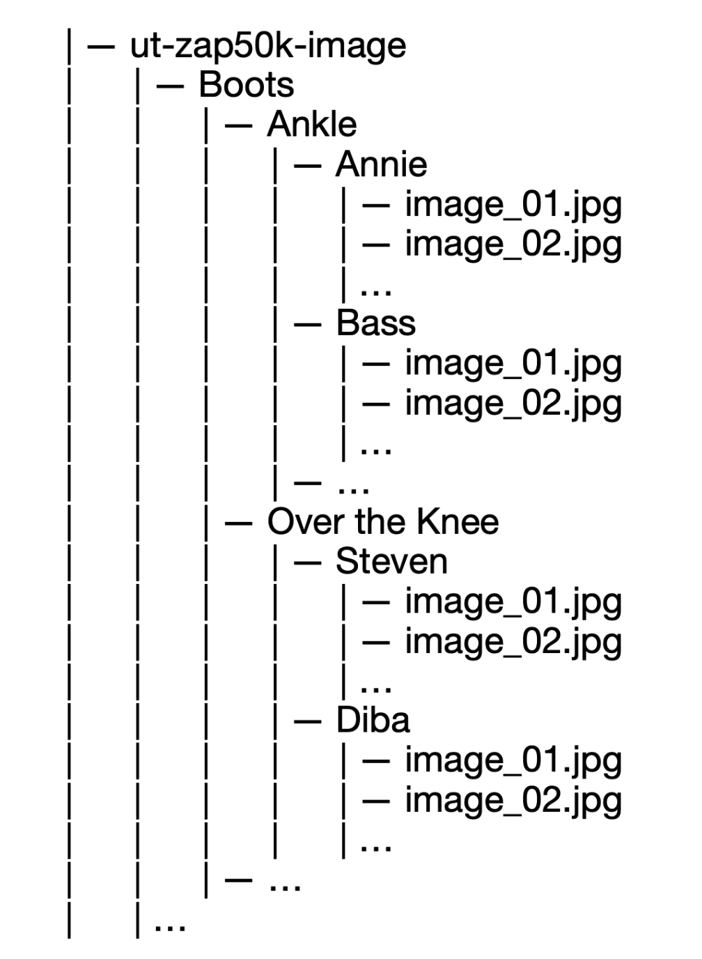
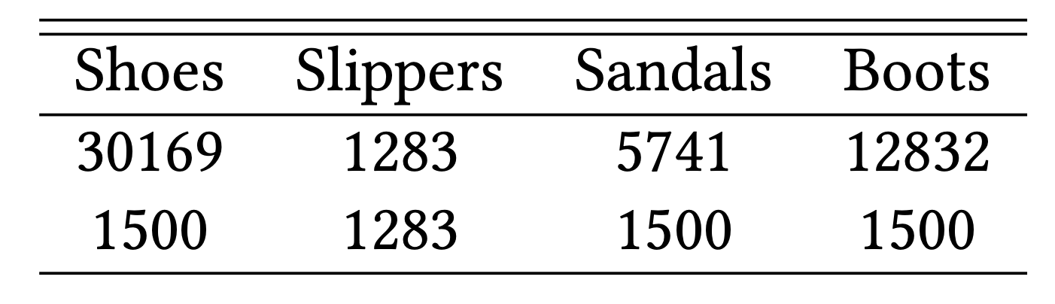
Dataset
http://vision.cs.utexas.edu/projects/finegrained/utzap50k/

Slide 5
Transfer Learning

Slide 6
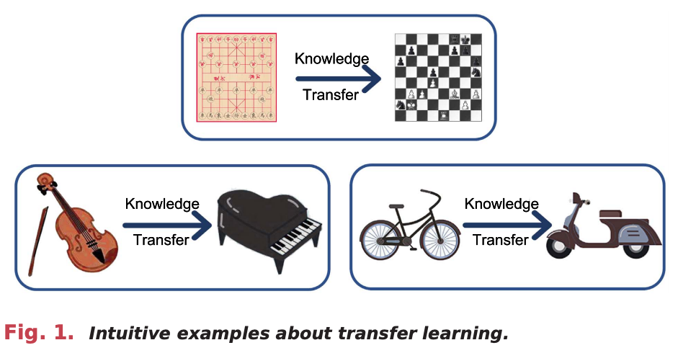
Transfer Learning

Slide 7
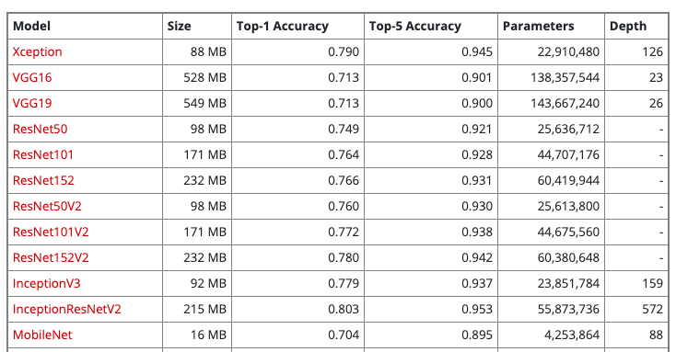
Xception
Table 1: Description

Slide 8
Xception
Figure X: Description

Slide 9
Implementation
scores
Probabilities
shoes
shoes
Xception
G.A.B
sandals
sandals
softmax
slippers
slippers
2048, 3, 3
2048
boots
boots
Figure X: Description

Slide 10
Implementation
scores
Probabilities
shoes
shoes
G.A.B
sandals
sandals
Xception
softmax
slippers
slippers
3, 3, 2048
2048
boots
boots
scores
Probabilities
FC
+
Relu
shoes
shoes
sandals
sandals
Xception
G.A.B
softmax
slippers
slippers
2048, 3, 3
2048
boots
boots
512
Figure X: Description

Slide 11
Siamese Network

Slide 12
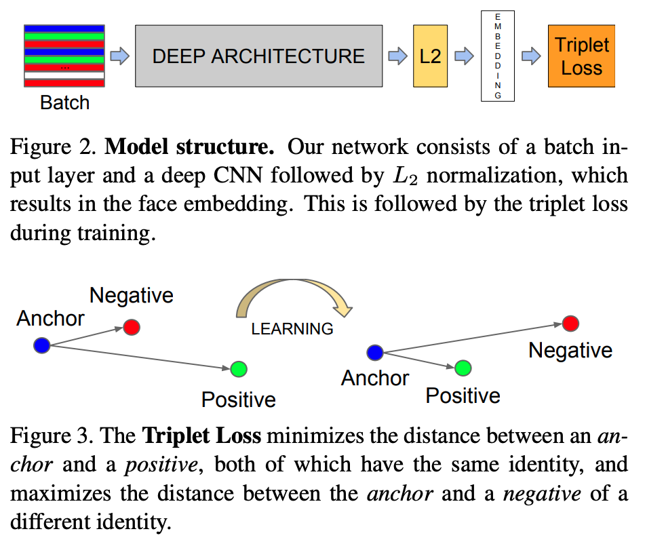
Siamese Network
FC
Loss
Classes
Our network consists of a batch input layer and a deep CNN followed by L2 normalization, which results in the image embedding. This is followed by a loss function during training. Furthermore, we add one more FC layer to generate classes output.
SCHOOL OF - to apply in all slides at the same time edit in Insert > Header & Footer

Slide 13
Siamese Network
FC
Loss
Classes
Our network consists of a batch input layer and a deep CNN followed by L2 normalization, which results in the image embedding. This is followed by a loss function during training. Furthermore, we add one more FC layer to generate classes output.
SCHOOL OF - to apply in all slides at the same time edit in Insert > Header & Footer

Slide 14
Typical CNN Architecture
Figure X: Description

Slide 15
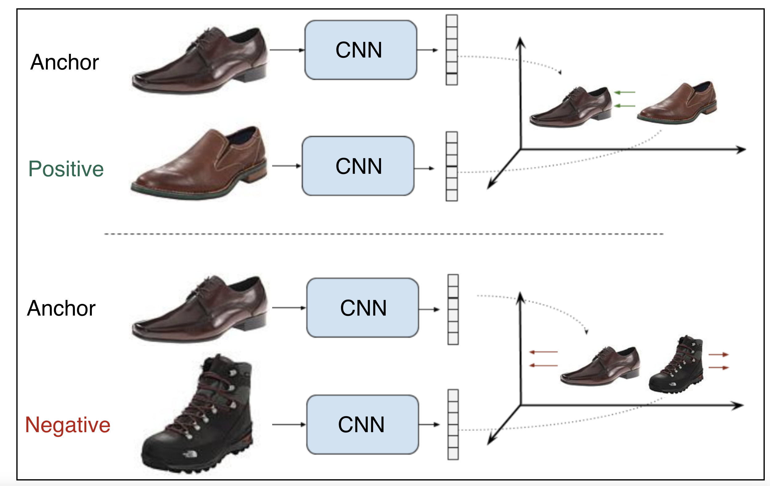
Contrastive Loss
Shared weights
pull
push
Shared weights
Figure X: Description
SCHOOL OF - to apply in all slides at the same time edit in Insert > Header & Footer

Slide 16
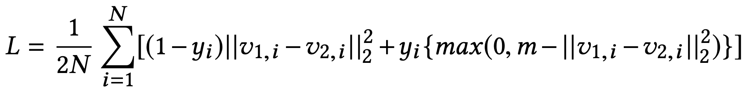
Contrastive Loss
Assume x_{a,i},x_{p,i},x_{n,i} are the anchor sample, positive sample and negative sample in a triplet respectively. v_{a,i},v_{p,i},v_{n,i} are their correspondent embedding vectors. y_{i} is the binary label that equals 1 for a positive pair and 0 for a negative pair. m is the marge and N is the batch size.
SCHOOL OF - to apply in all slides at the same time edit in Insert > Header & Footer

Slide 17
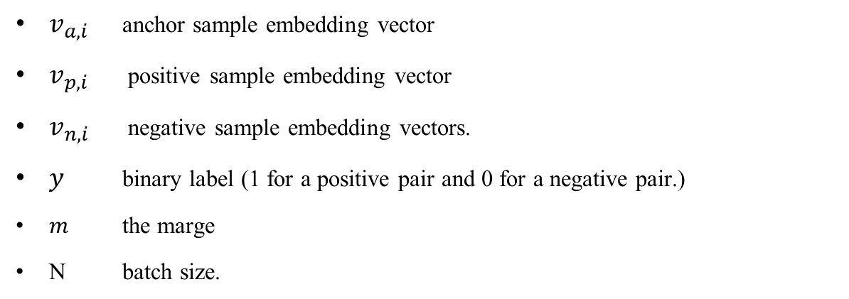
Contrastive Loss Function
$v_{a,i}$ anchor sample embedding vector
$v_{p,i}$ positive sample embedding vector
$v_{n,i}$ negative sample embedding vectors.
$y$ binary label (1 for a positive pair and 0 for a negative pair.)
$m$ the marge
N batch size.
SCHOOL OF - to apply in all slides at the same time edit in Insert > Header & Footer

Slide 18
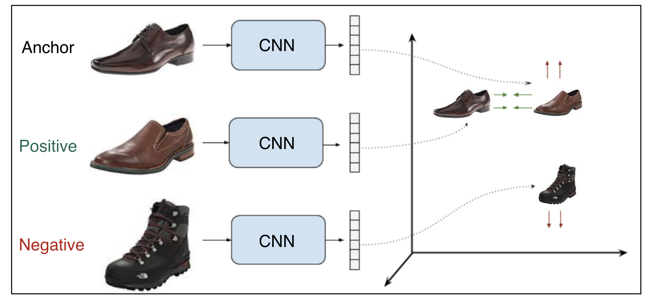
Triplet Loss
Shared weights
pull
push
Shared weights
Figure X: Description
SCHOOL OF - to apply in all slides at the same time edit in Insert > Header & Footer

Slide 19
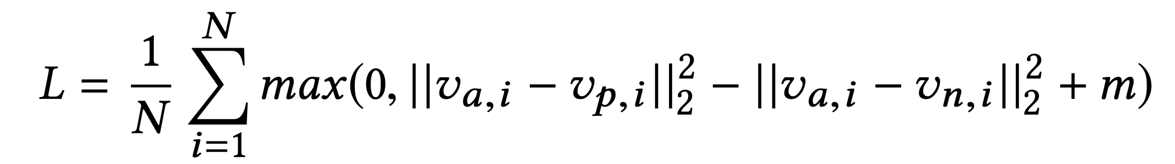
Triplet Loss
Assume x_{a,i},x_{p,i},x_{n,i} are the anchor sample, positive sample and negative sample in a triplet respectively. v_{a,i},v_{p,i},v_{n,i} are their correspondent embedding vectors. m is the marge and N is the batch size.
SCHOOL OF - to apply in all slides at the same time edit in Insert > Header & Footer

Slide 20
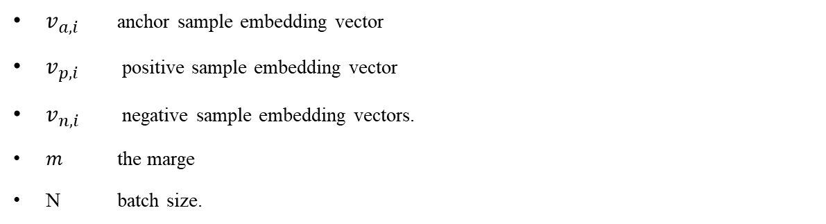
Triplet Loss Function
$v_{a,i}$ anchor sample embedding vector
$v_{p,i}$ positive sample embedding vector
$v_{n,i}$ negative sample embedding vectors.
$m$ the marge
N batch size.
SCHOOL OF - to apply in all slides at the same time edit in Insert > Header & Footer

Slide 21
Triplet Loss
https://www.tensorflow.org/addons/tutorials/losses_triplet

Slide 22
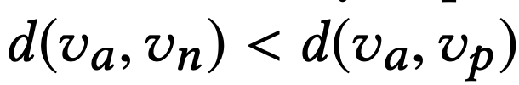
Triplet Mining
Easy negatives
Semi-hard negatives
Hard negatives
margin
A
P
Figure X: Description
SCHOOL OF - to apply in all slides at the same time edit in Insert > Header & Footer

Slide 23
Implementation

Slide 24
Pairs

Slide 25
Implementation
Offline pair mining
defined before training
Online triplet mining
defined for every batch during training

Slide 26
Evaluation

Slide 27
Evaluation – old run
model | Accuracy % | Epochs | Time (mins)
Xception | 91.8 | 20 | 1.8
Xception + dense | 90.7 | 20 | 3.5
Xception All | 95.1 | 10 | 5.4
Our Siamese + Con. loss | 92.75 | 32 | 6
Our Siamese + Triplet. loss | 91.02 | 20 | 2
Xception + Siamese | 95.85 | 10 | 2
model | Accuracy % | Epochs | Time (mins)
Xception | 89.9 | 20 | 4
Xception + dense | 89.3 | 20 | 4
Xception All | 94.0 | 10 | 6
Our Siamese + Con. loss | 90.20 | 32 | 14
Our Siamese + Triplet. loss
Xception + Siamese
Table1: 1500 images
Table2: 2500 images

Slide 28
Evaluation – new run
model | Accuracy % | Epochs | Time (mins)
Xception | 93.61 | 20 | 2.1
Xception + dense | 94.65 | 20 | 2.5
Xception All | 97.4 | 10 | 2.2
Our Siamese + Con. loss | 92.75 | 32 | 6
Our Siamese + Triplet. loss | 91.02 | 20 | 2
Xception + Siamese | 95.85 | 10 | 2
model | Accuracy % | Epochs | Time (mins)
Xception | 91.8 | 20 | 4
Xception + dense | 90.7 | 20 | 4
Xception All | 94.0 | 10 | 6
Our Siamese + Con. loss | 90.20 | 32 | 14
Our Siamese + Triplet. loss
Xception + Siamese
Table2: 1500 images
Table3: 2500 images

Slide 29
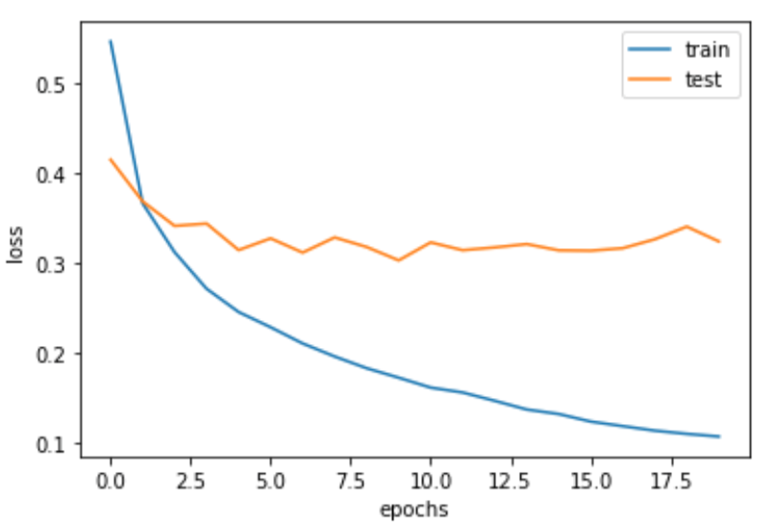
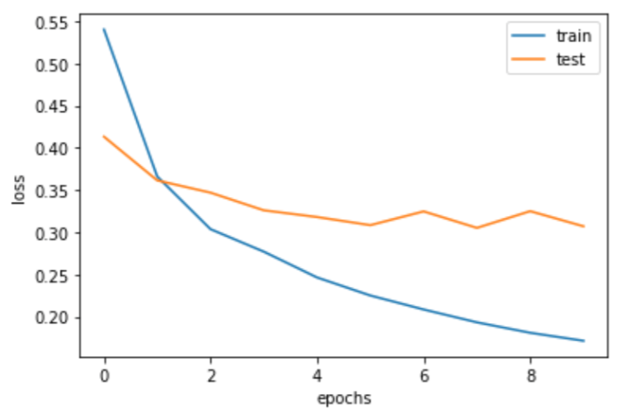
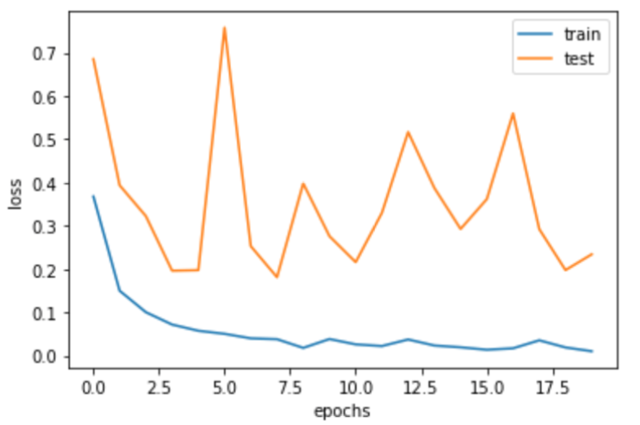
Transfer Learning
(a) Xception
(b) Xception + dense
(c) Xception All
Figure X:

Slide 30
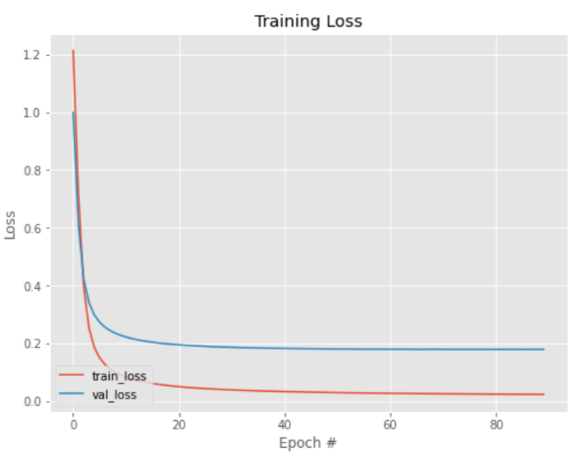
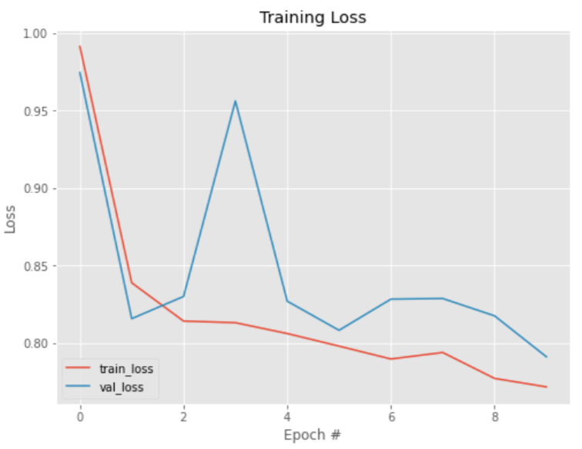
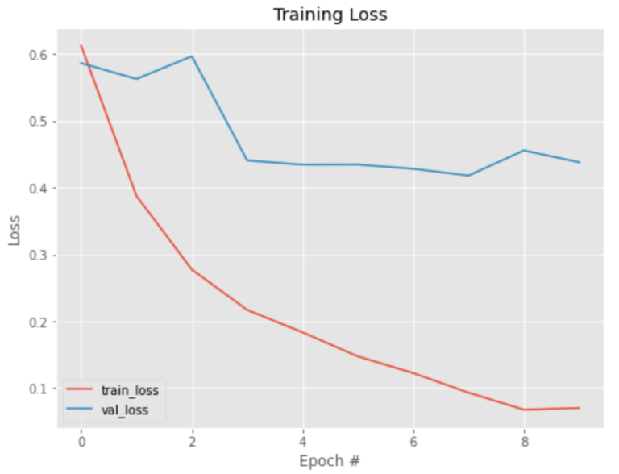
Contrastive Loss
Our Siamese + Con. loss
Our Siamese + Triplet. loss
Xception + Siamese
Figure X: Description

Slide 31
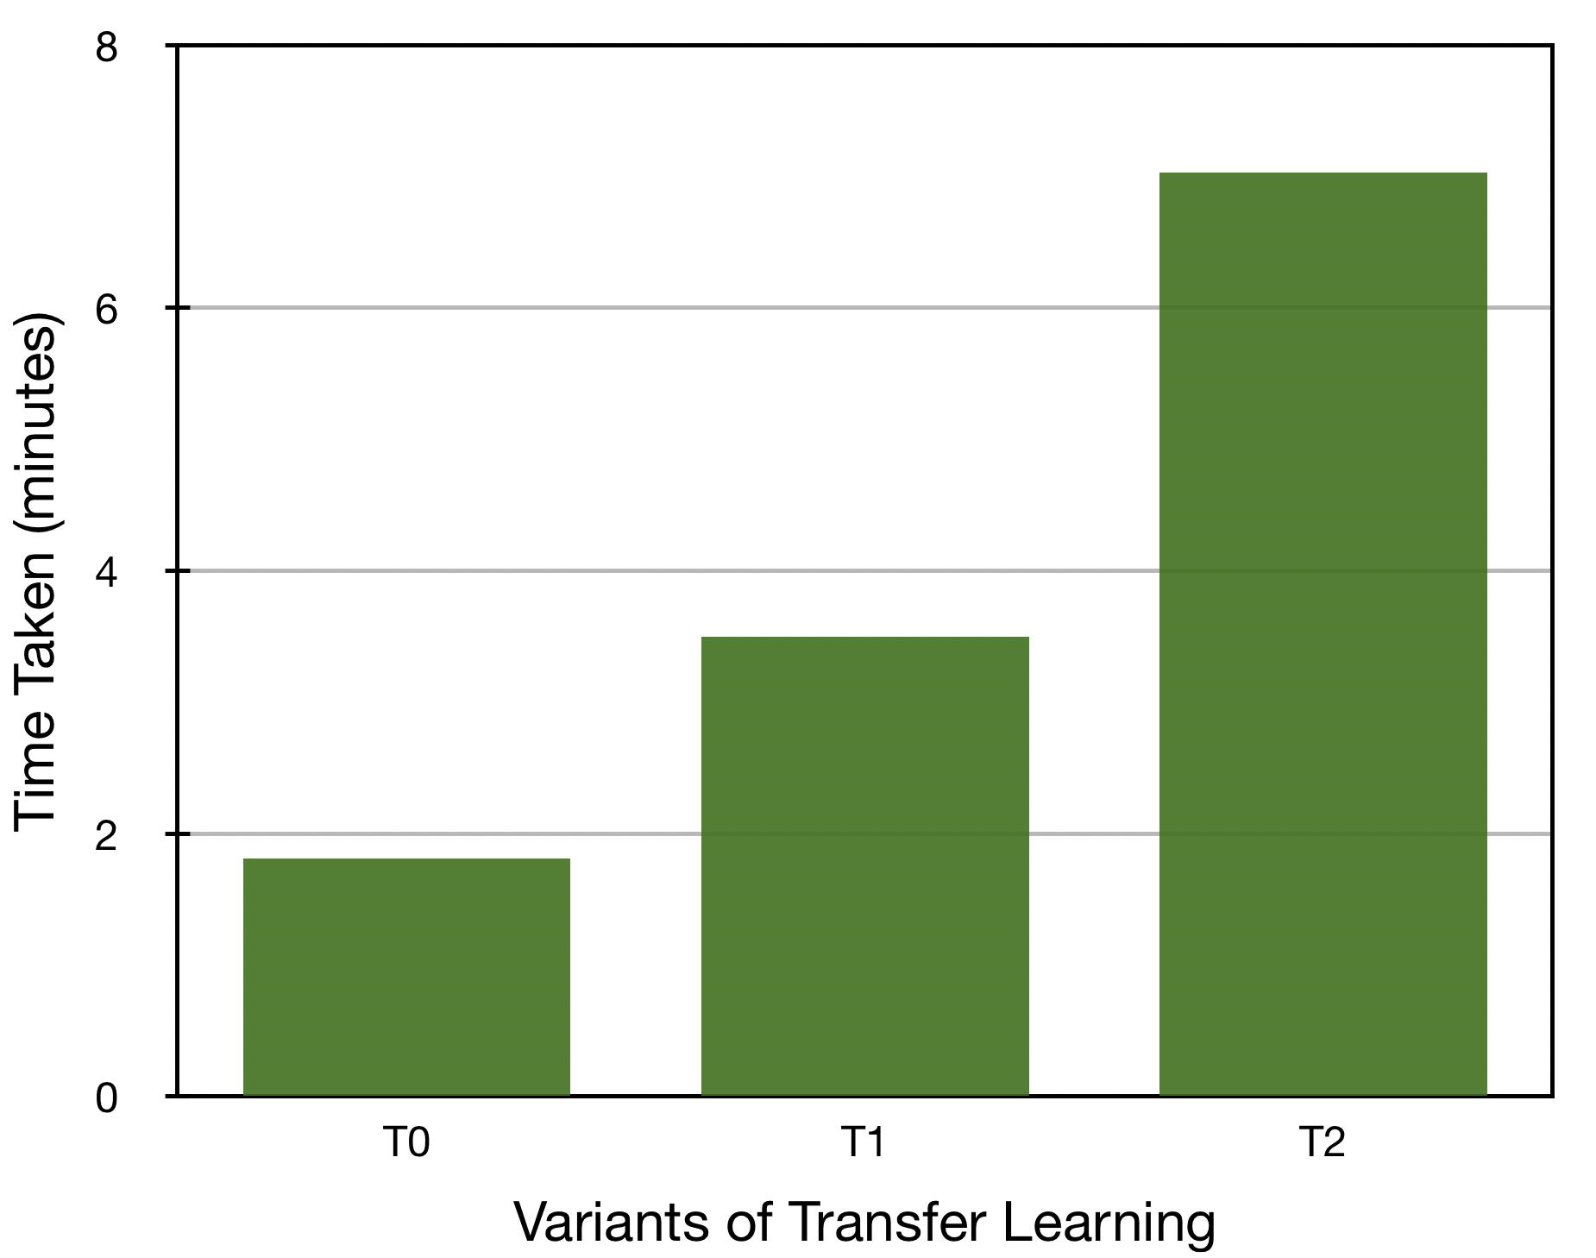
Comparison of Transfer Learning
Figure X: Description

Slide 32
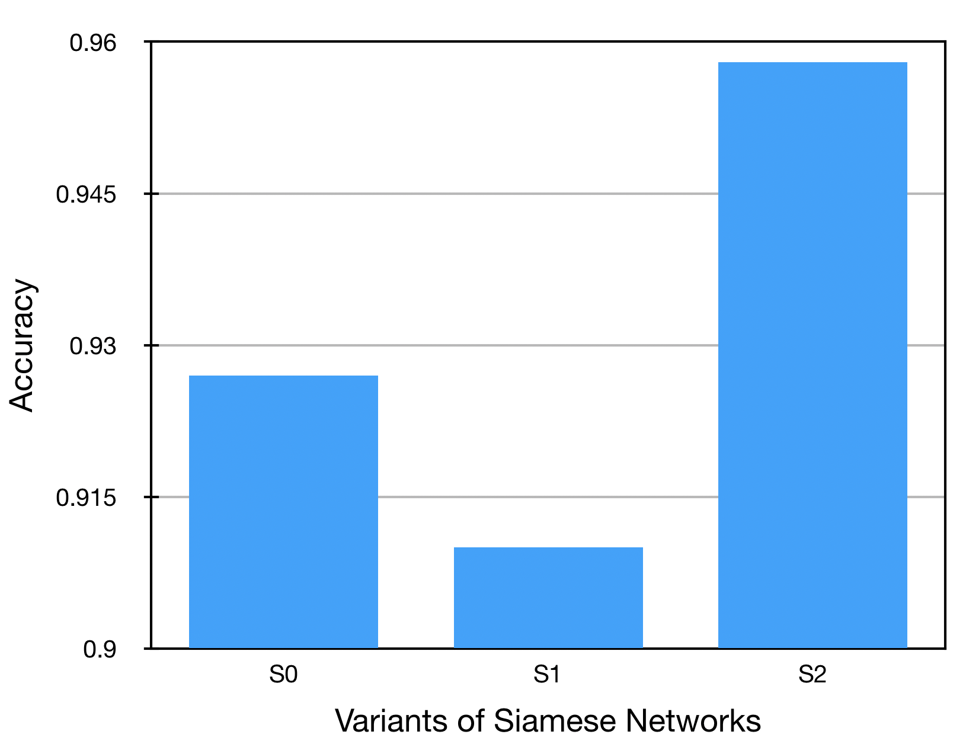
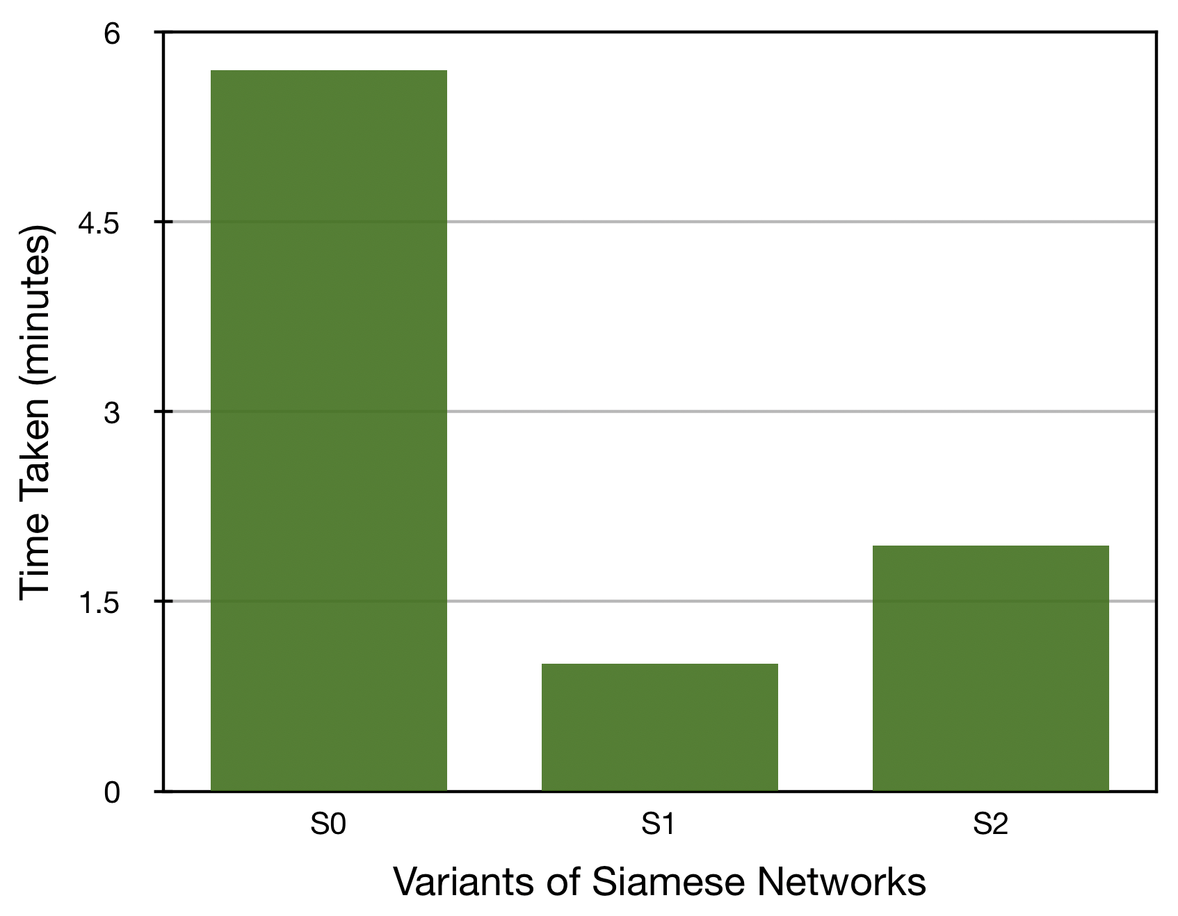
Comparison of Siamese Network
Figure X: Description

Slide 33
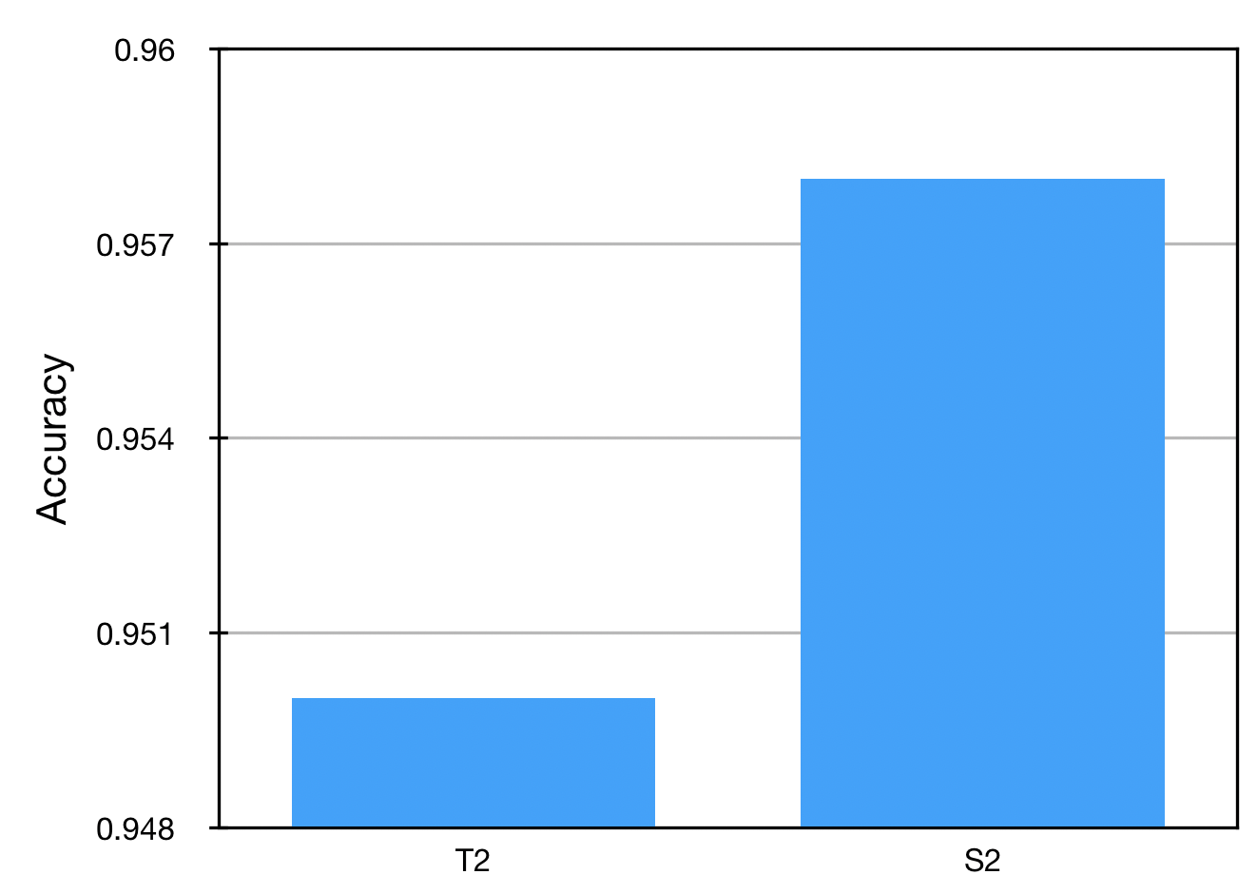
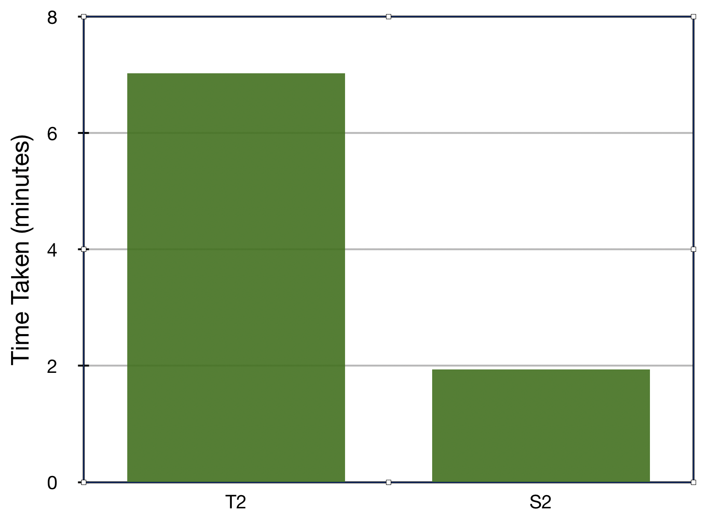
Comparison best models
Figure X: Description

Slide 34
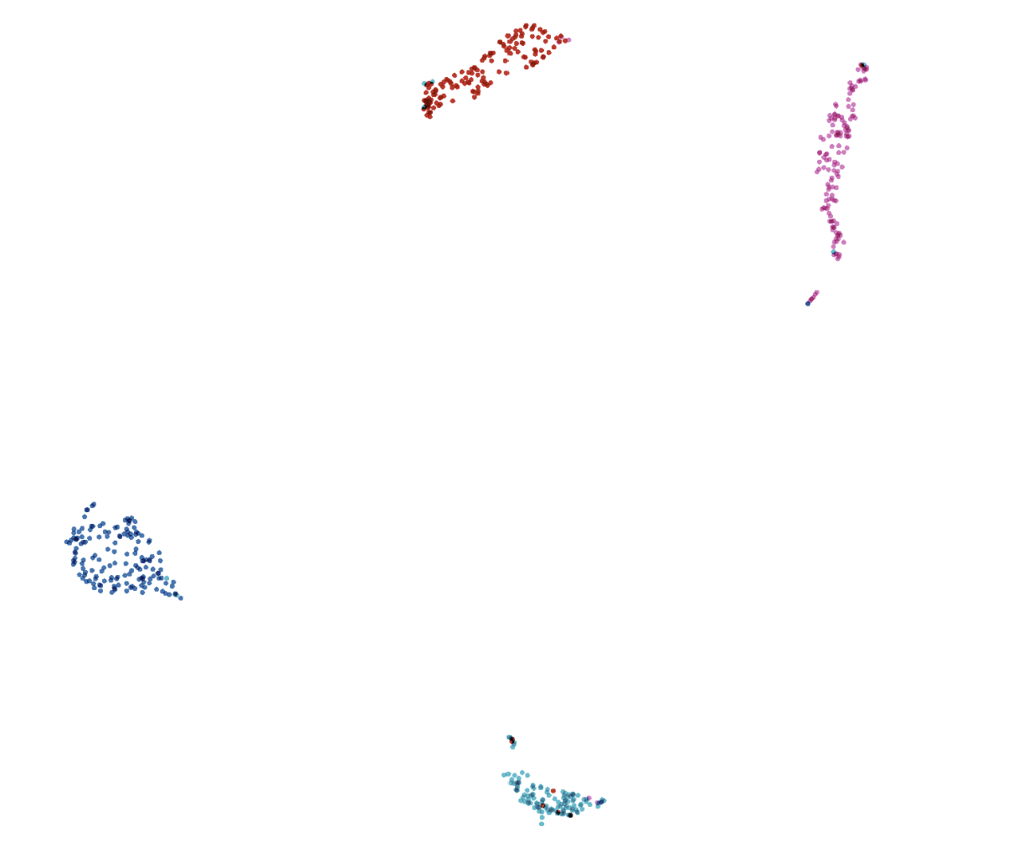
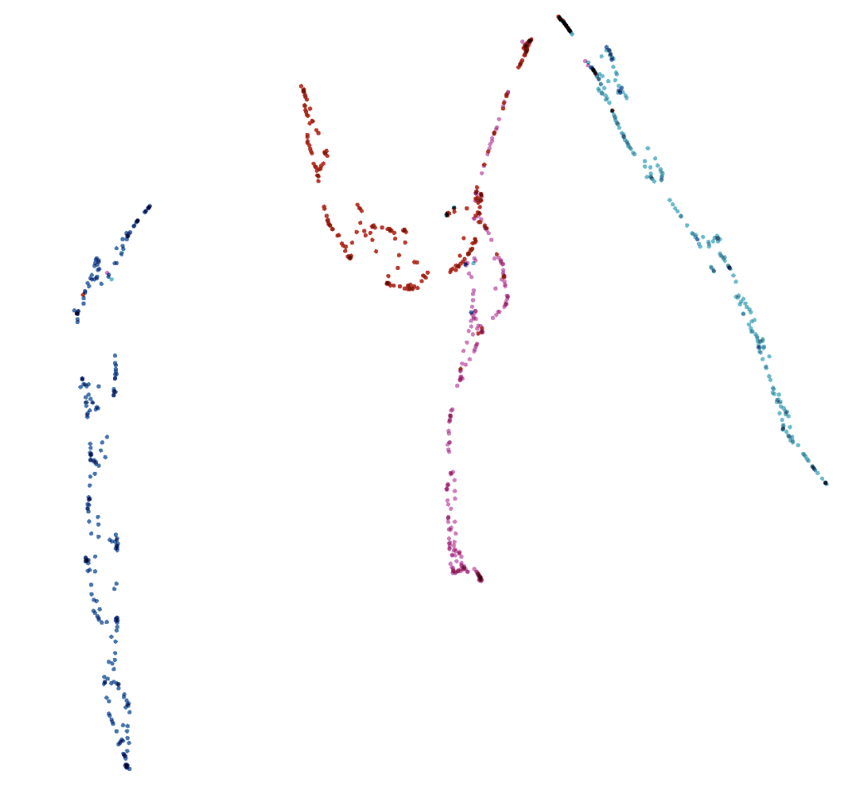
Comparison best models
(a) Xception + Siamese
(b) Xception all
Figure X: Embedded test data visualized with UMAP
using https://projector.tensorflow.org/

Slide 35
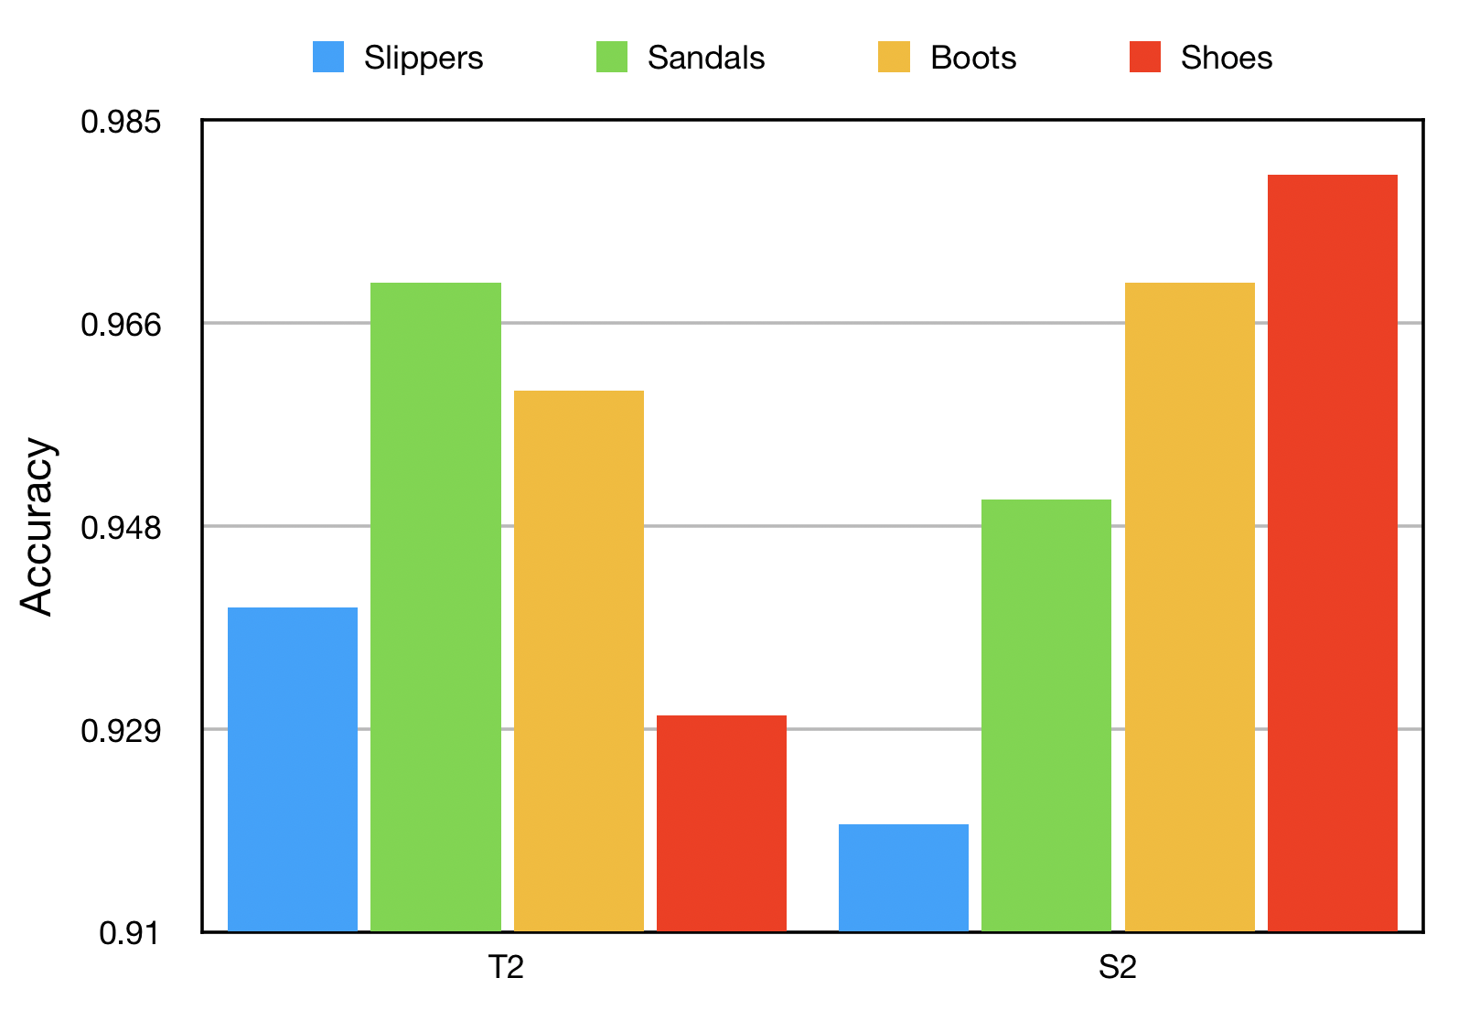
Analyze each class
Figure X: Description

Slide 36
Thank you!

